Slide 1
SHELL FORM TRANSFORMERS
Moscow - November 2018

Slide 2
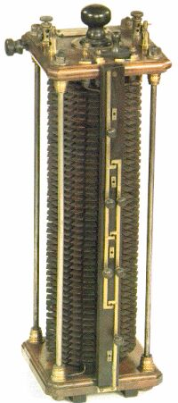
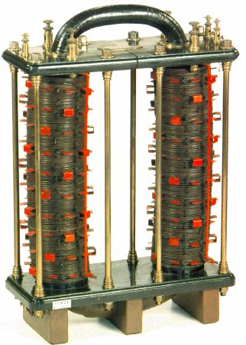
Introduction to Shell Form
Lucien Gaulard and John Dixon Gibbs exhibited a 'secondary generator' in London in 1882 and sold the idea to Westinghouse (USA) who developed shell form technology transformers in the United States from early 20th century,
In the 50’s, Mitsubishi (Japan) and Jeumont-Schneider (France) (est. 1905) - former JST signed license agreements with Westinghouse Electric Corp. and began manufacturing shell-form transformers.
Other manufacturers followed (in USA, Belgium, Spain, China, Portugal …).

Slide 3
Shell vs Core, what are the differences?
LV Winding
Shell type :
Magnetic circuit: rectangular, surrounds the phase.
Phase: also almost rectangular
Windings groups: coaxial and alternate
HV Winding
HV Winding
LV Winding
?
Core type :
-Phase: circular
- Windings: concentric.
They surround the core which section is circular
Magnetic circuit
Magnetic circuit
Shell type
Core type

Slide 4
three phase: Shell vs Core
Three-phase configuration
Shell type
Core type

Slide 5
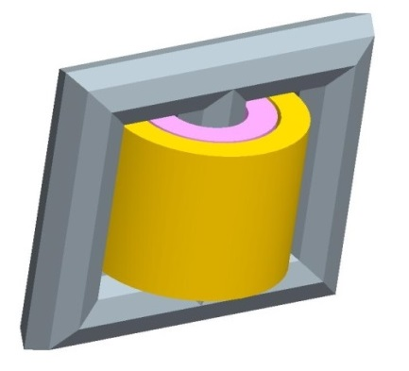
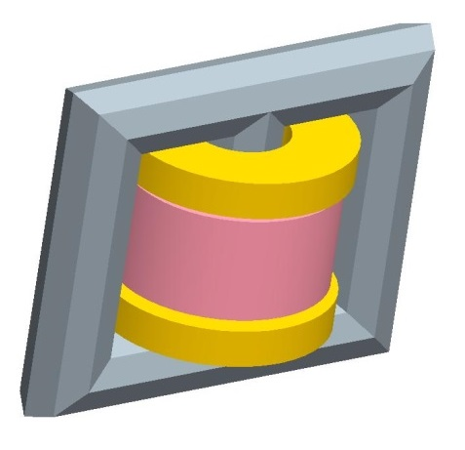
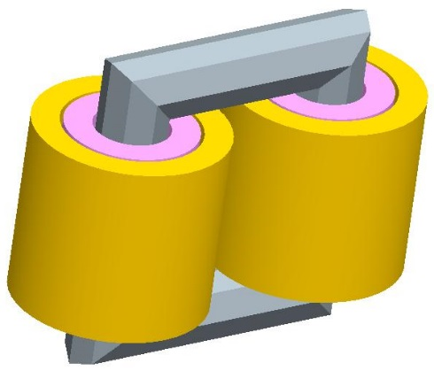
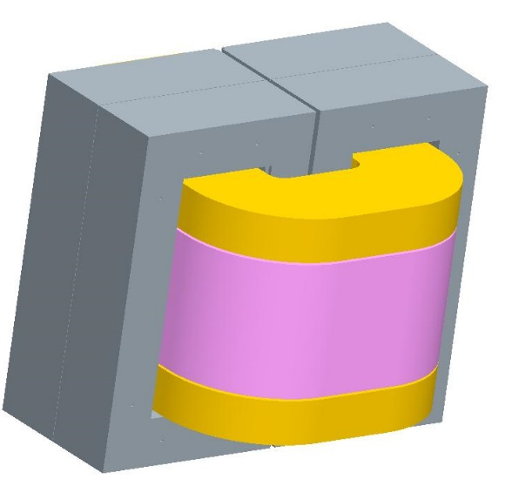
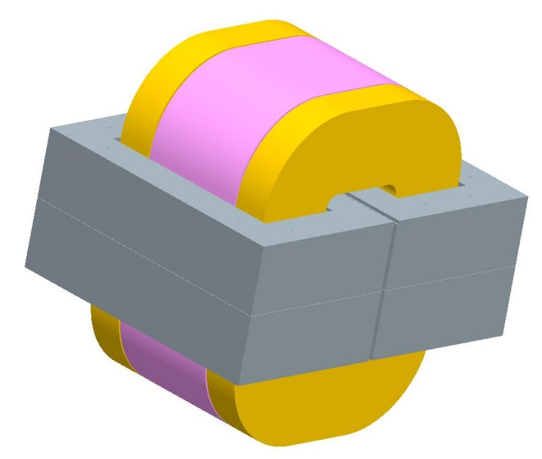
Shell vs Core transition in single phase
Single phase core-type with interleaved windings
Single phase core type with concentric windings
Single phase core type with 2 windings per leg
Laid-down shell-type
Upright shell type

Slide 6
Shell form: Core construction
Single phase
Three phase
Ex : 8 x 8 SLC cutting
The same width for all laminations
Simplicity of design
Easiness to cut laminations
Accuracy of stacking
The magnetic circuit is free flux type
Same laminations width in all yokes

Slide 7
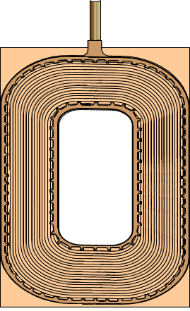
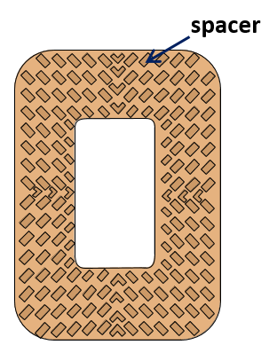
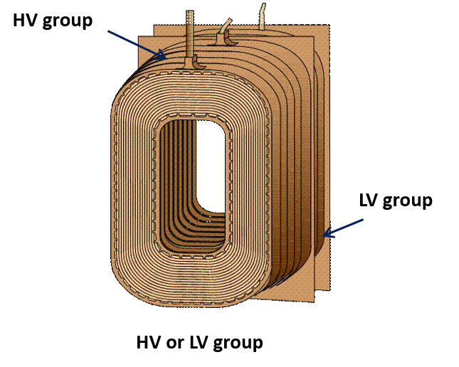
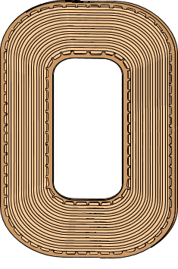
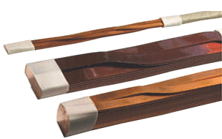
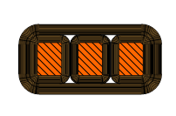
Shell form: Phase construction (1)
Pancake coil
Insulating pressboard with spacer
Pancake coil
etc…
CTC
cable
Windings: all made with rectangular flat «pancake» coils
Insulation between pancakes : pressboard washers with spacers
Windings: coaxial. All coils go around the same magnetic circuit
Adding coils: does not modify the mean turn of the group
Phase: sum of all the groups , alternating HV and LV along the phase axis
« standard »
cable

Slide 8
Shell form: Phase construction (2)
The phase:
built,
dried
and oil impregnated

Slide 9
Shell Form: Tank construction
Magnetic shields
Magnetic shields
Tank base

Slide 10
Shell Form: Assembly (1)
HV group
Wood wedgings:
- inserted between phase and base walls
LV groups
Tank base reinforcements

Slide 11
Shell Form: Assembly (2)
Phase
Magnetic shields
Steel wedgings :
- inserted between phase and core
Magnetic circuit
T beam: support the magnetic core, and reinforce the base
Magnetic shields

Slide 12
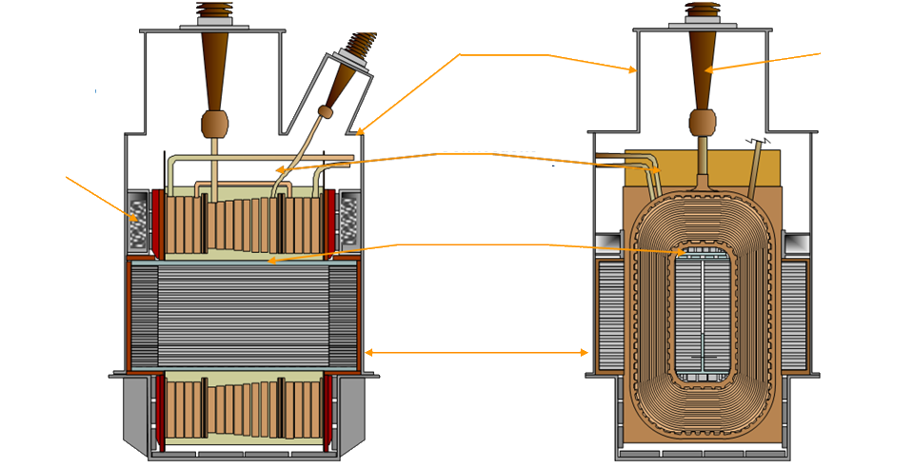
Shell Form: General configuration
Cover
Bushing
Springs to press the magnetic circuit
Connections
Wedgings of the phase
Form-fit tank
(very close to the active part)

Slide 13
as built Shell Form
Single phase transformer
Three phase transformer

Slide 14
Impedances vs Winding arrangements
General formula :
The leakage flux circulates around one winding only. The lines have a radial direction
G = 2 (2 HiLo) with impedance Z
With the same main data (power, voltages …), the 4 HiLo transformer impedance is half the one of a 2 HiLo transformer
Easiness to match whatever specified impedance, even low, just by playing on the windings arrangement, possibility of three or four secondaries with specific impedances
G = 4 (4 HiLo) ➔ impedance = Z / 2

Slide 15
Shell Form: Short Circuit Withstand
Limited Axial Forces
coil
Main short circuit forces are in the axial direction.
Radial forces: negligible due to the accurate alignment of magnetic centers between coils and between groups.
Note: When changing the winding arrangement from a 2 HiLo to a 4 HiLo, with the same impedance, the total electrodynamic forces on the winding are divided by 2
spacer
Pressboard

Slide 16
Dielectric withstand example: Full wave applied on HV line
C_{T}
U
L
U(x)
LV
LV
C_{T}
C_{S}
HV
C_{T}
C_{S}
C_{T} : capacitance to earth
C_{S} : series capacitance
L : inductance
C_{T}
L
C_{T}
% of applied voltage
The windings of a shell-form transformer have very favorable geometry for a good surge voltage distribution :
The surfaces of the coils are very large ➔ high series capacitances Cs
The coils present their thin edges towards the magnetic circuit ➔ low capacitances to earth CT
α=0
α=10
naturally low
% of winding from line

Slide 17
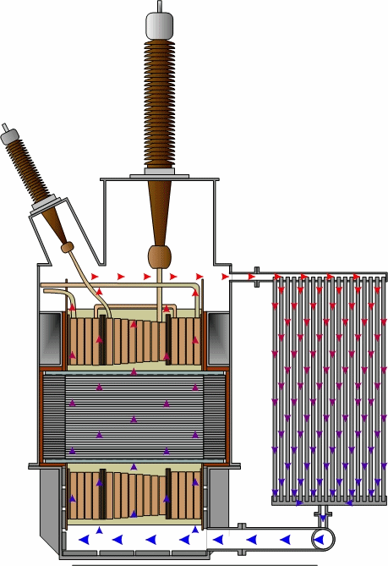
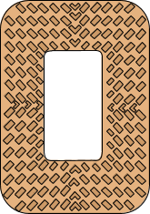
Shell Form: Thermal behavior
For all types of cooling (natural, forced) oil is always directed into the windings
The oil :
enters into the base,
is fully directed inside the windings
and then calories are evacuated by the coolers
All elementary coils are cooled on each side thanks to oil channels made by the spacers path on pressboard washers
The homogeneity of oil flow in each oil channel and the large surface of coils in contact with oil allow a very efficient cooling

Slide 18
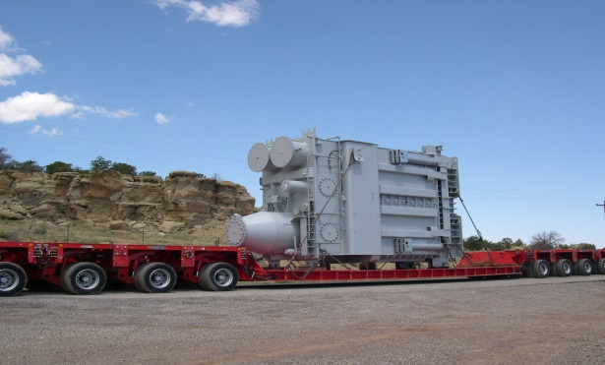
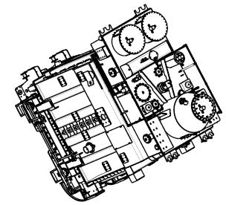
Shell Form: Transportation
Single phase shell form transformers can be shipped laid down
Smaller gauge (shipping height)

Slide 19
Shell Form advantages
Compactness :
Rectangular geometry
Form-fit tank very close to the active part
Reduced volume of oil (reduced oil-pit volume as well)
Capacitances & Impedance :
Natural high series capacitances of windings due to large surface
Natural low capacitances to earth due to the small thickness of coils
Easiness to match whatever specified impedance
Cooling efficiency :
Oil always directed into the phases
Large surface of coils for a better cooling
Coils cooled on each side
Easy adaptation to any type of cooling
Structural:
Reduction of short-circuit forces by playing on the number of Hi-Lo channels
Windings sustained by both magnetic and tank reinforcements
Looseness mastering by both axial and radial wedgings

Slide 20
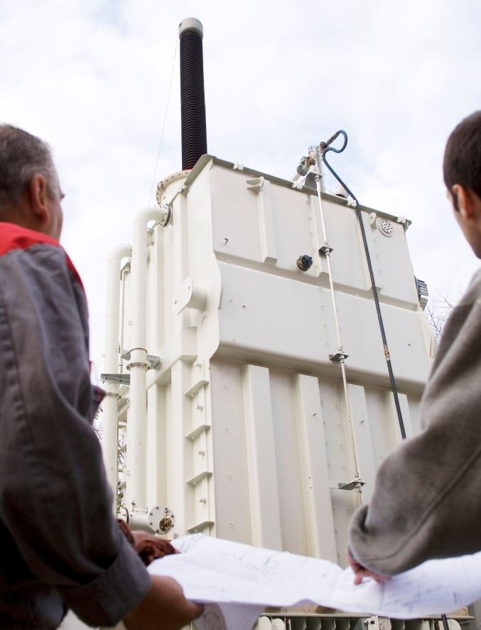
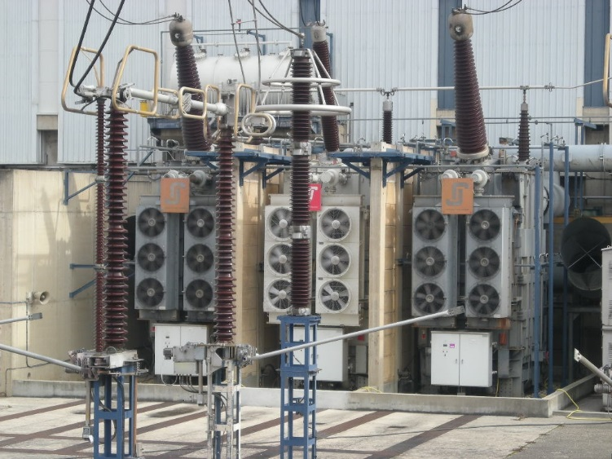
JST transformateurs: Shell Form Single Phase GSU (NPP)
NPP GSU since the 70’s for EDF Nuclear Power Plants, from the 900 MWe NPP up to the 1650 MWe EPR NPP
=> Over 120 units delivered to EDF NPP - 360/550/570/650 MVA*
650*MVA 405/23 kV
EPR- Flamanville- France
360*MVA 400/24 kV
France
  * Continuous rating per phase Plus many Three Phase ANTs and ASTs (34, 96, 100MVA) from 70’s up 2016

Slide 21
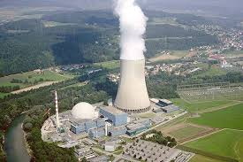
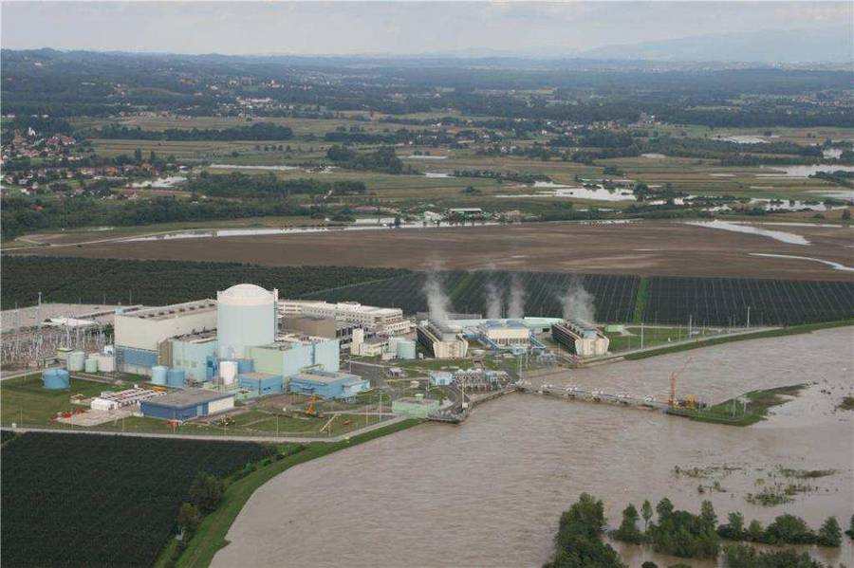

JST transformateurs: Export Nuclear experiences
  KKG - Switzerland 970 MWe
  Gösgen Nuclear Power Plant - commercial operation: November 1rst , 1979
  4 x 400 MVA (per phase) 24kV/409kV supplied in 2008
  Krško- Slovenia 730 MWe
  Krško Nuclear Power Plant - commercial operation: January 15th , 1983
  1 x 500 MVA 21/400kV supplied in 2000

Slide 22
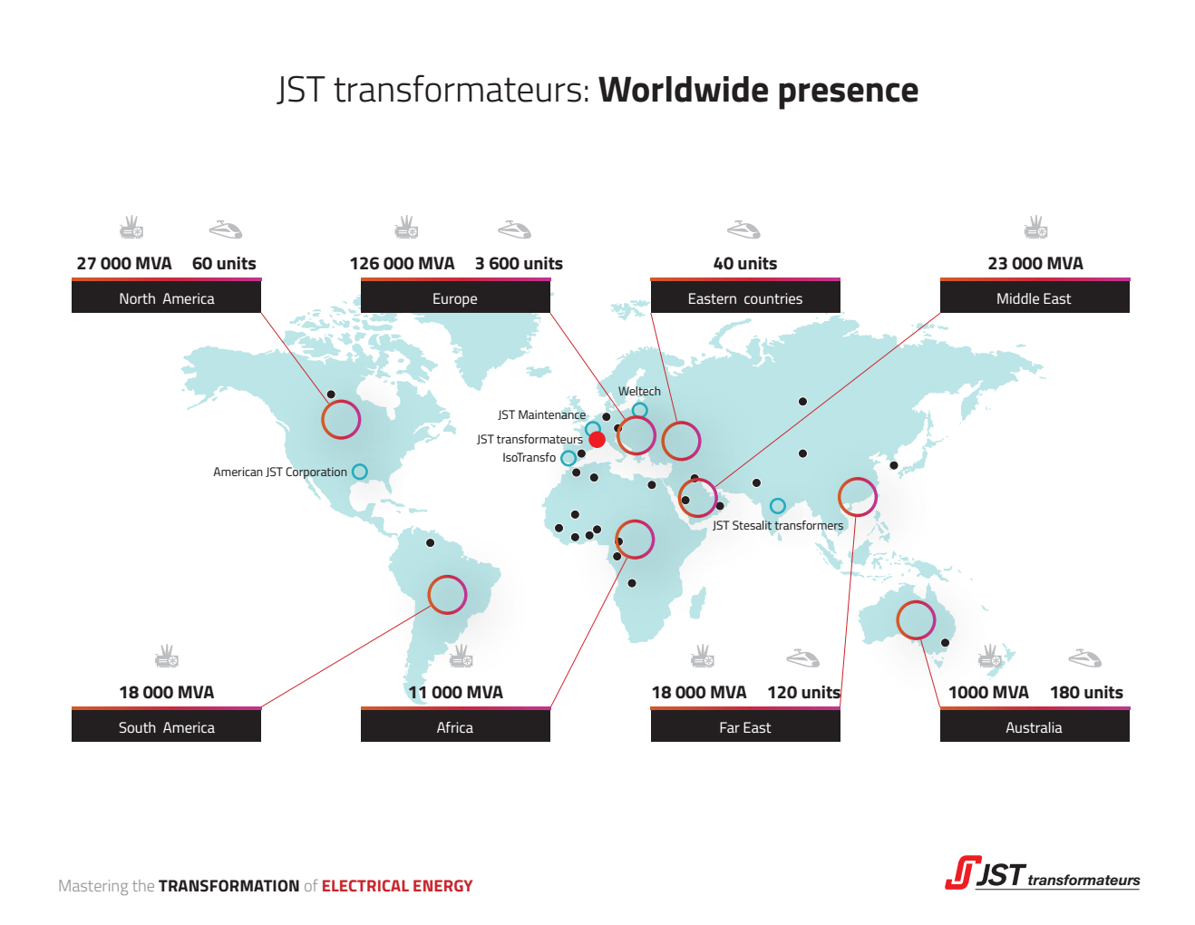



Headquarter & main plant
Industrial or commercial subsidiaries
Transformers for Train: expressed in units.
Other Power Transformers: expressed in cumulated delivered MVA

Slide 23
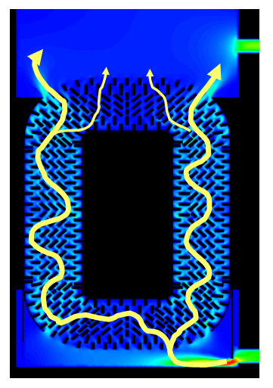
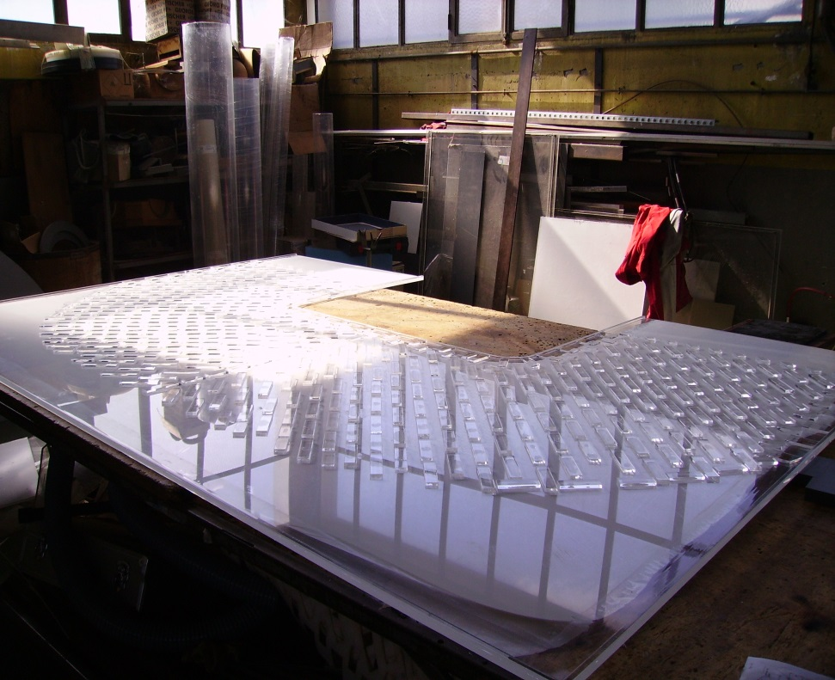
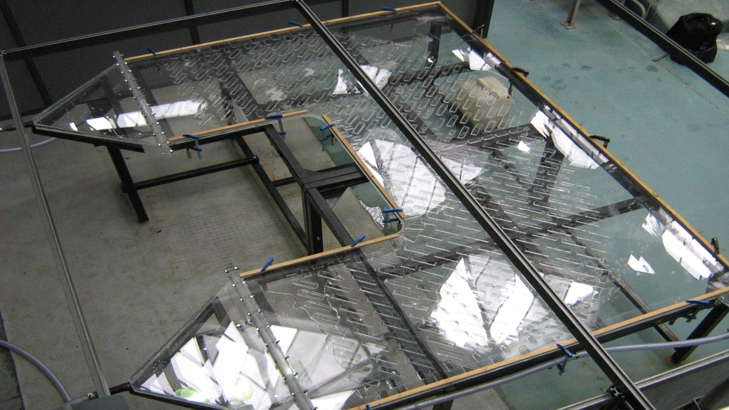
R&D main topics
Hydraulic model
Development of a CFD (Computational Fluid Dynamics) model and measurements on an equivalent mock-up to validate the hypothesis of the numerical calculations.
Simulation of the complete transformer using the same hypothesis.
Plexiglas mock-up in progress
Mock- up

Slide 24
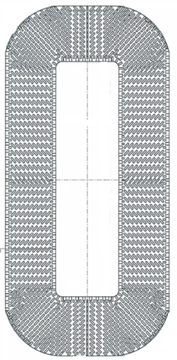
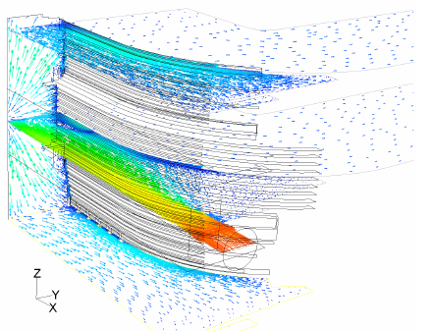
Construction of an hydraulic model
R&D main topics
This mock-up allows to check and match :
the oil flow at the lower part of a pressboard washer,
Outlets
the oil flow upper part of a pressboard washer
Inlets
Outlets
Inlets

Slide 25
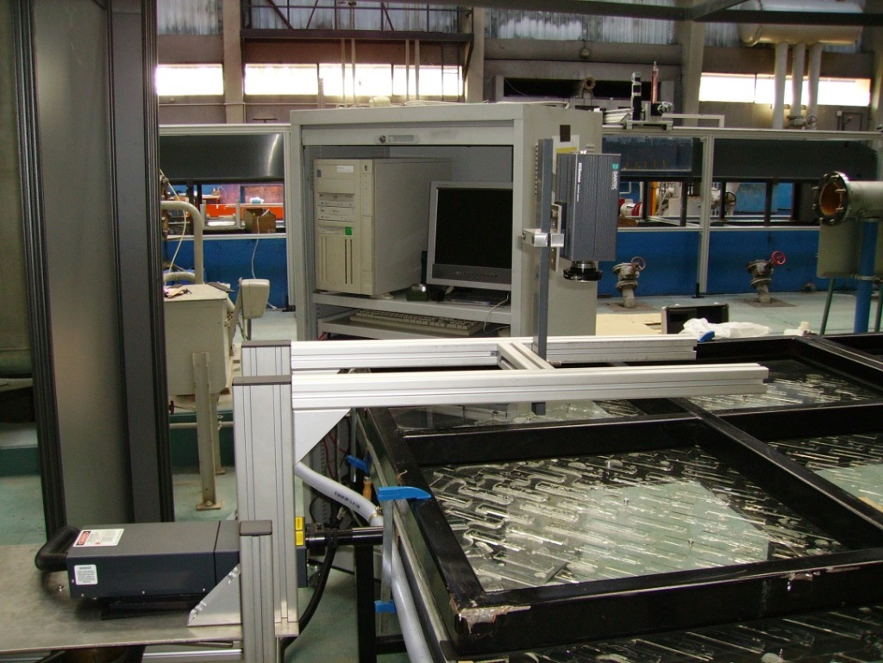
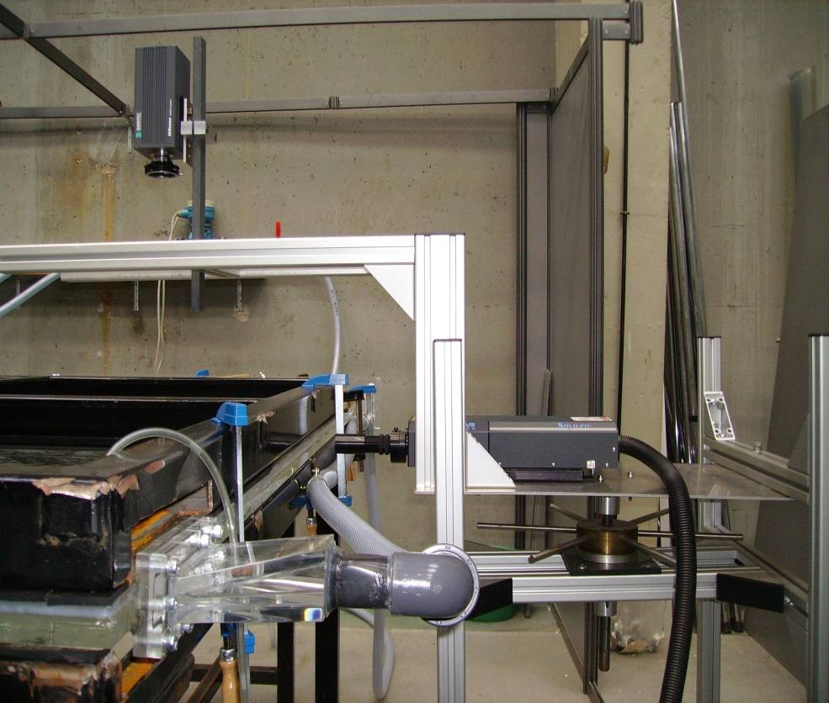
Oil speed measurement by Particle Image Velocimetry (PIV)
R&D main topics
Treatment signal station
Camera
Laser (reflects the particles circulation)

Slide 26
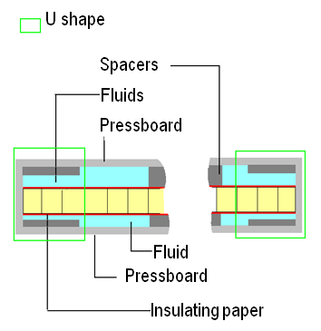
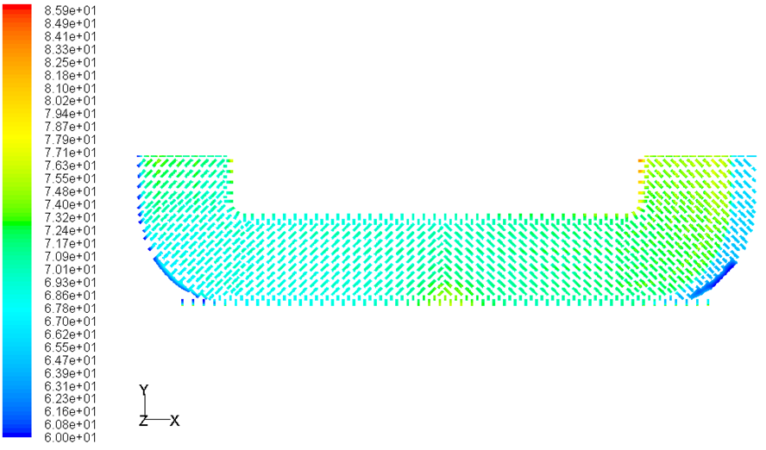
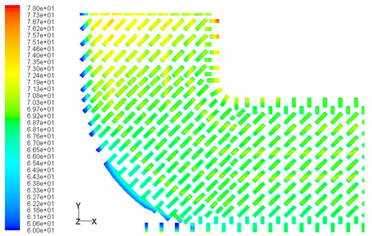
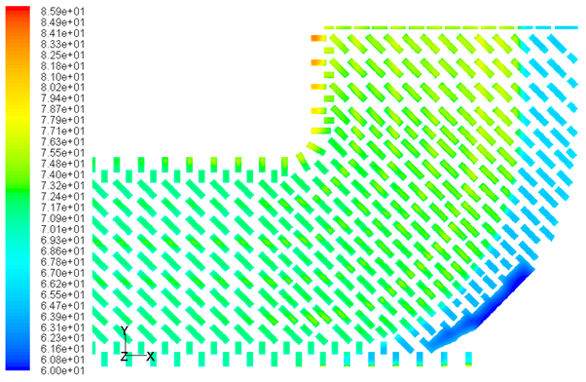
Thermal-hydraulic simulation of a shell type coil
R&D main topics
Temperatures under spacers

Slide 27
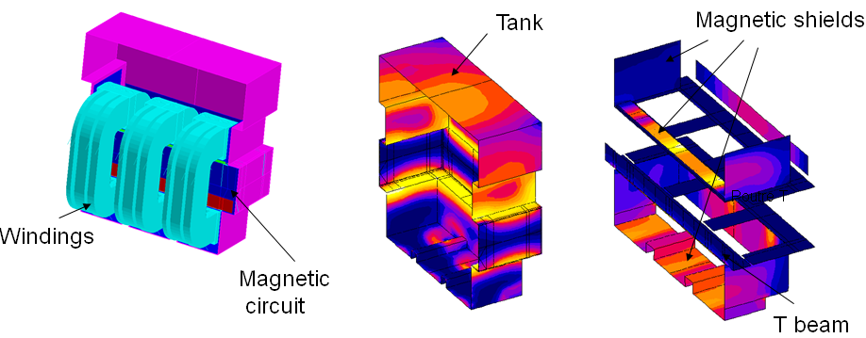
Mastering Load Losses due to leakage flux
R&D main topics

Slide 28
VVER 1000 Main Transformer typical characteristics
General characteristics:
Generator Step-Up transformer
Shell Type Transformer
417 MVA HV= 420/√3 kV - LV =24 kV
Connection diagram YNd11 (for three phase group)
De-energized tap changer HV neutral side +/-2x 2,5 %
HV Insulation level
  U_{m} 420 / SI 1175 / LI 1425 / LIC 1550 / AC 630 kV
LV Insulation level
  U_{m} 24 / LI 150 / LIC 175 / AC 65 kV
Impedance and Losses:
Ucc = 14,45 % +/- 7 % base 417 MVA
No Load Losses = 164 kW +/- 15 %
Load Losses = 770 kW +/- 15 %
Auxiliary losses = 75 kW +/- 15 %
Cooling and Structural:
ODAF : 4 air coolers + 4 pumps

Slide 29
Any question?

